Slide 1
Data Management Project
Estimize Dataset
Group No: 27
Teja Natireddi
Yashwant Sai Kishore

Slide 2

Problem Statement
Estimize, an open web-based platform, has become a valuable source for retrieving financial estimates.
It facilitates the aggregation of financial estimates from a diverse community of individuals.
To Build an EPS database that stores the analyst’s forecasts and accurate EPS for the companies

Slide 3

Contents

Slide 4
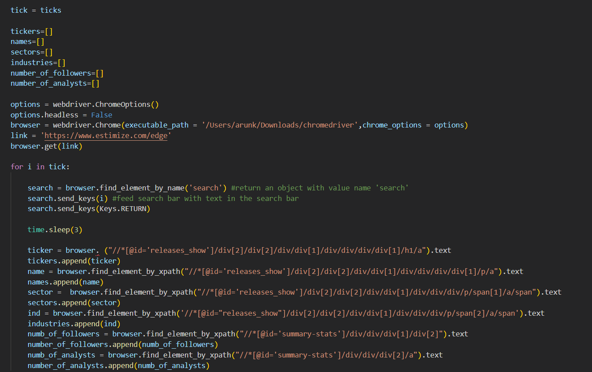
Data Scraping - Selenium
Used Selenium to extract the basic information of each company, analysts info & their basic details
Included dynamic sleep to avoid the forbidden error on the webpage
Stored the information in the form of a pandas data frame for data insertion

Slide 5
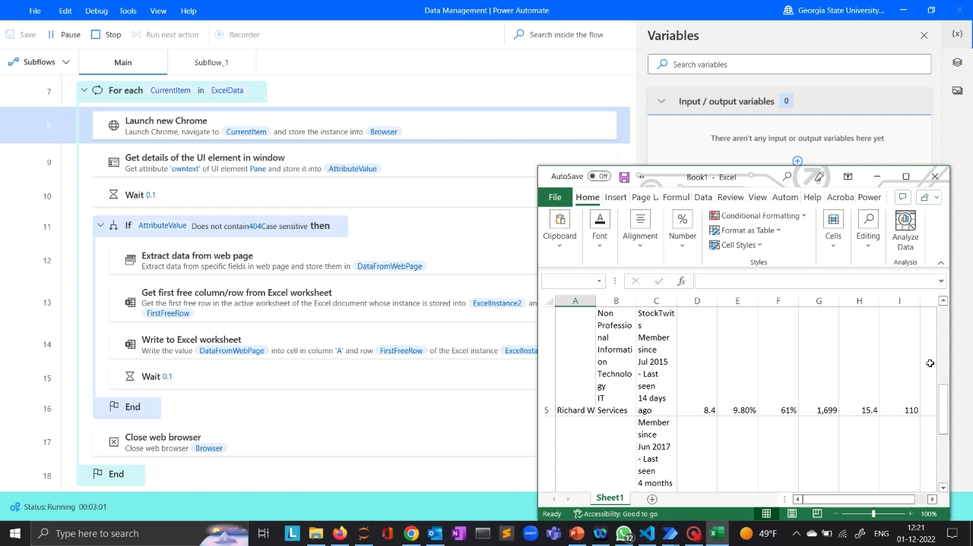
Data Scraping - RPA

Slide 6

DATA PREPROCESSING
Merged multiple excel files in which the data was extracted from the webpage
Dropped the duplicate records of the extracted data frame.
Changed the case of the text data to lowercase wherever necessary
Performed string operations such as replacing the special characters
with empty spaces
Changed the data type of attributes such as date field to MySQL Date Time, numeric data to int and float

Slide 7
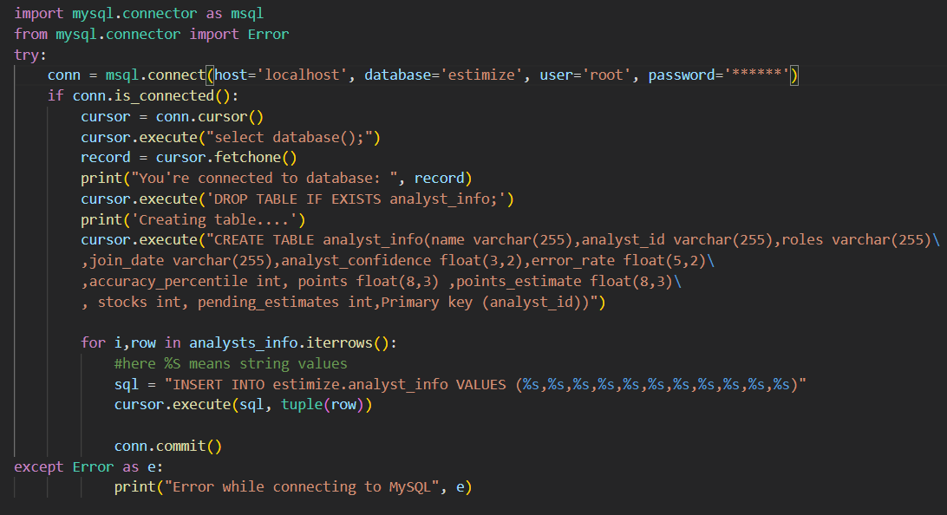
DATA INSERTION
Initiated a connection to MySQL using the MySQL connector library
Connected to estimate database to Insert the data
Performed CRUD operations
Defined the primary keys and referential integrity before loading the data into the tables.

Slide 8
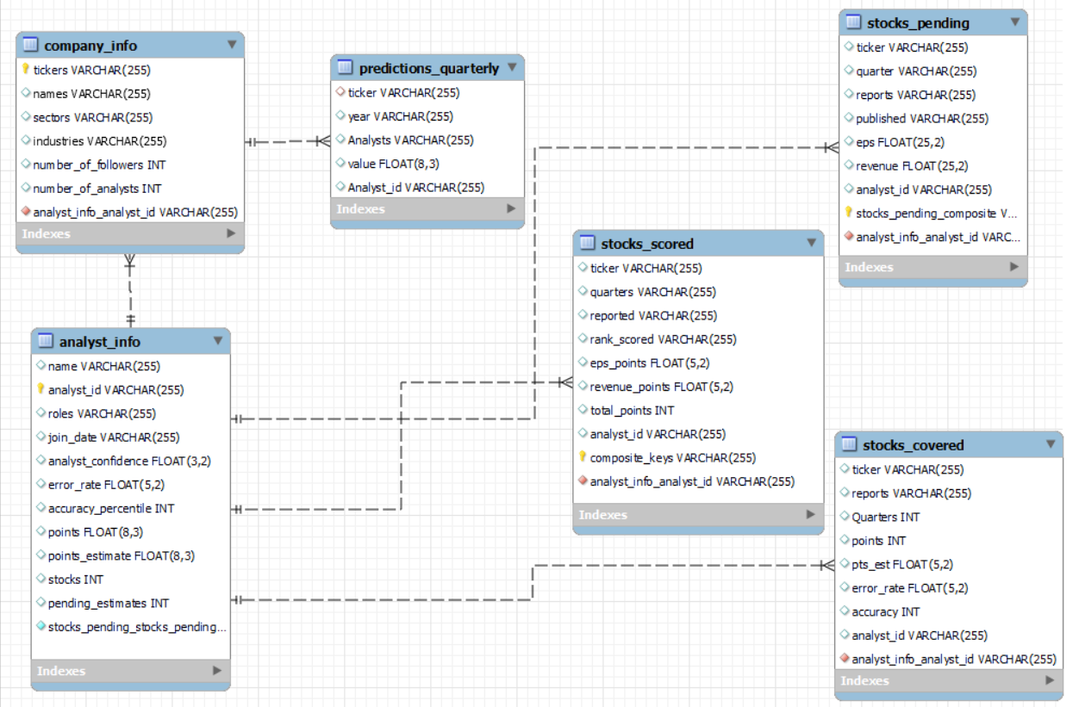
ENTITY RELATIONSHIP MODEL
The Company info table has information about the no of followers and analysts.
Prediction info table consists of analysts of each company and their rank.
The analysts info consists of information about each analyst.
Regarding Stocks we have three tables , these consists of the data regarding the revenue of each company.

Slide 9
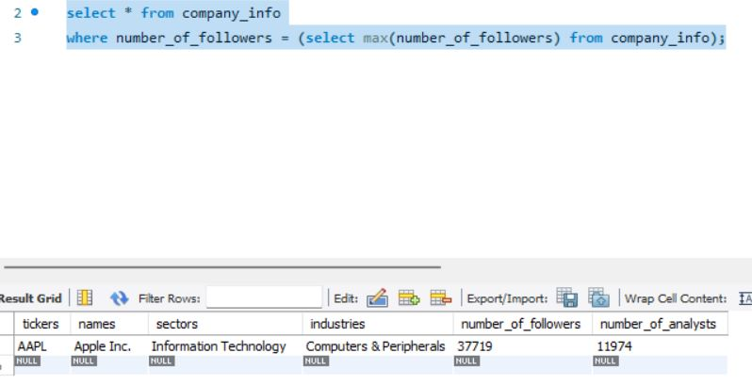
Query Example: Company with max no of followers?

Slide 10
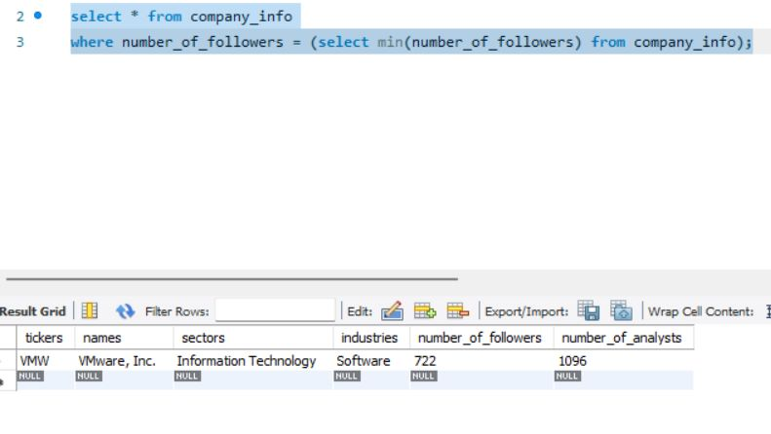
Query Example: Company with min no of followers?

Slide 11
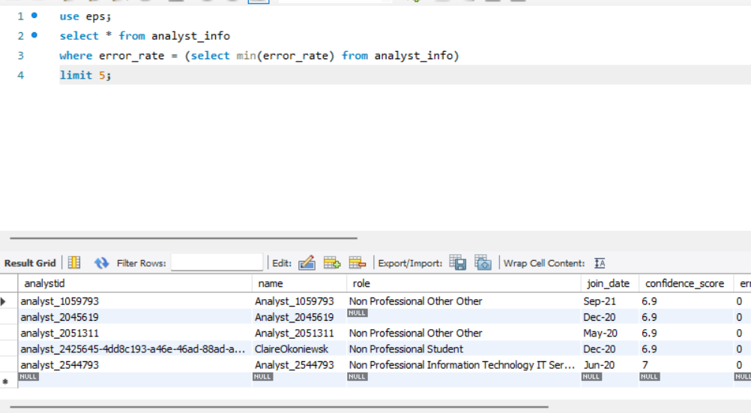
Query Example: Top 5 Analysts

Slide 12
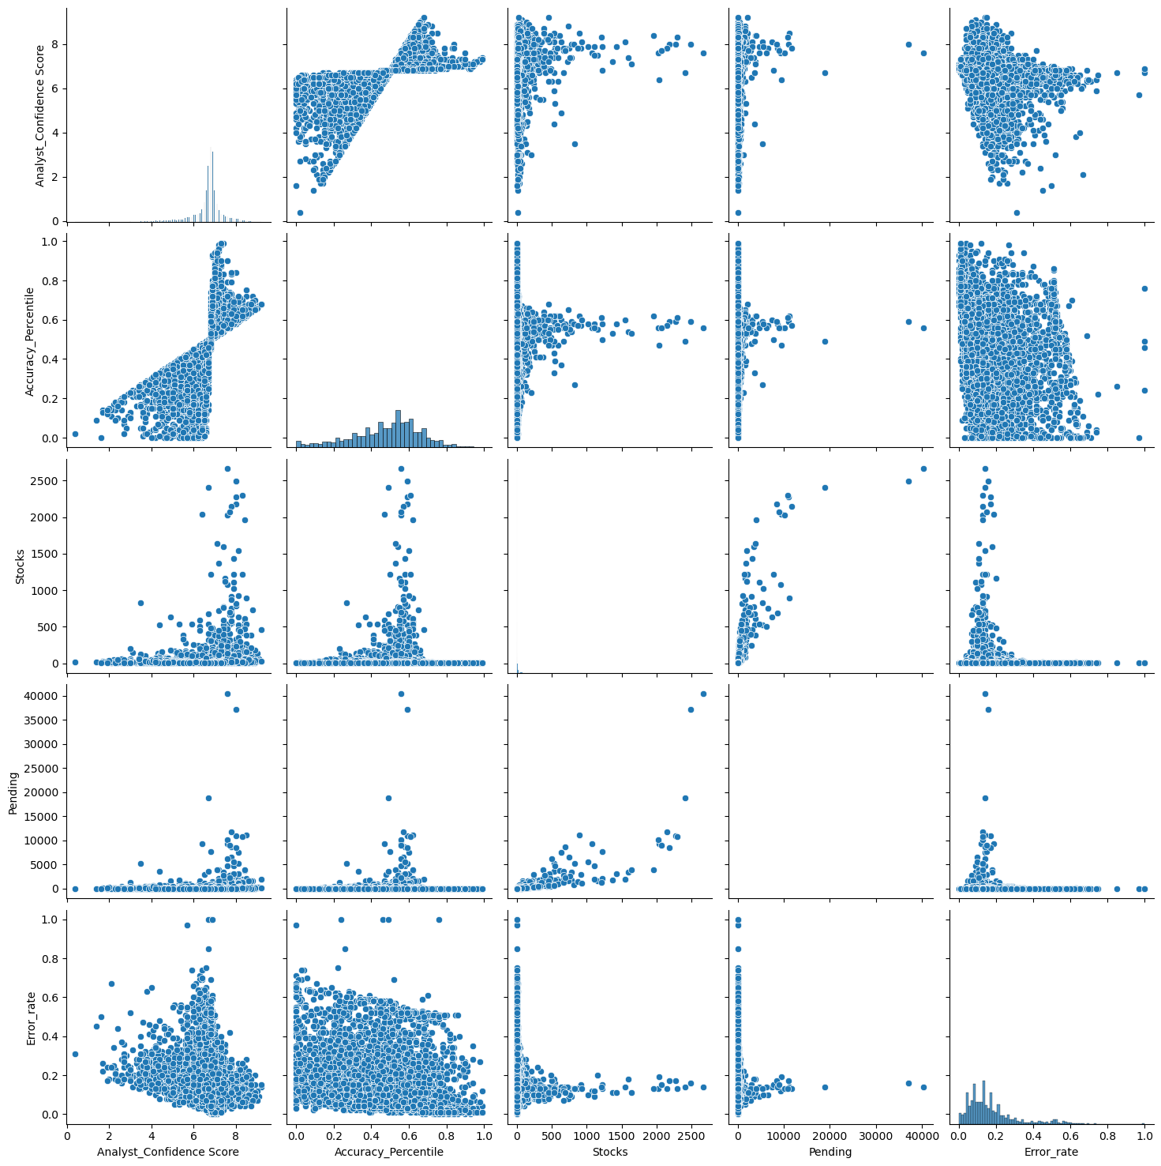
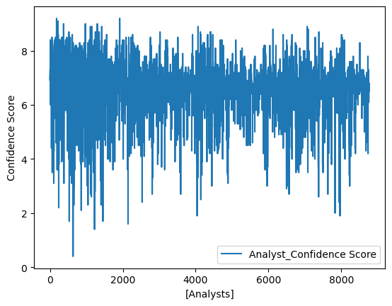
BONUS - REGRESSION MODEL
Pair Plot
Line Plot
Pair Plot – Visualize the numeric data
Line Plot – The average confidence score is – 6.67

Slide 13
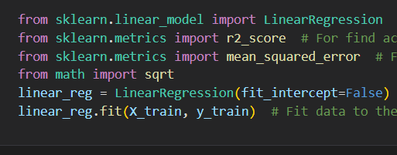
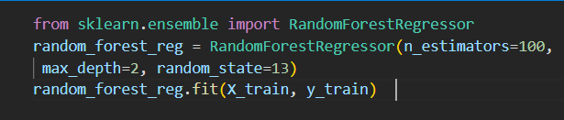
0.03917660043431979
0.03917660043431979
0.03917660043431979
Linear Regression
Random Forest Regressor
Accuracy: 60%
RMSE : 0.16683926645091696
Accuracy: 91%
RMSE : 0.03917660043431979

Slide 14
THANK YOU

